Slide 1
2023-09-27
Llama Lab Meeting
Dr. Bill Howe & Collaborators

Slide 2
Notes on Hybrid Hiring Dataset
Still pre-processing
Released data gives urls to bios taken from common crawl; doesn’t specify which crawl
No names in data—can’t disambiguate urls w/ multiple bios
Currently scraping from common crawl w/ http index, so may switch to (slow: ~350/7k done ~1 day)

Slide 3
Llama-2 on Colab
Llama-2-7b and Llama-2-13b fit on a T4 GPU (16GB)
Fine-tuned LoRA weights on a text summarization dataset for 1,000 examples with no issues
Llama-2-70b does not fit, even in 4-bit precision with double quantization
70b might fit on a 40GB A100, but I consistently lose the A100 instance lottery
GPT-Neo-X-20b fits on a T4 GPU, but crashes due to memory issues
After fewer than 100 examples, using HF trainer class, with gradient checkpointing
Batch sizes need to be very small to prevent OOM (1-4, max)
During internship, also found that sequence length can cause crash with larger batch size

Slide 4
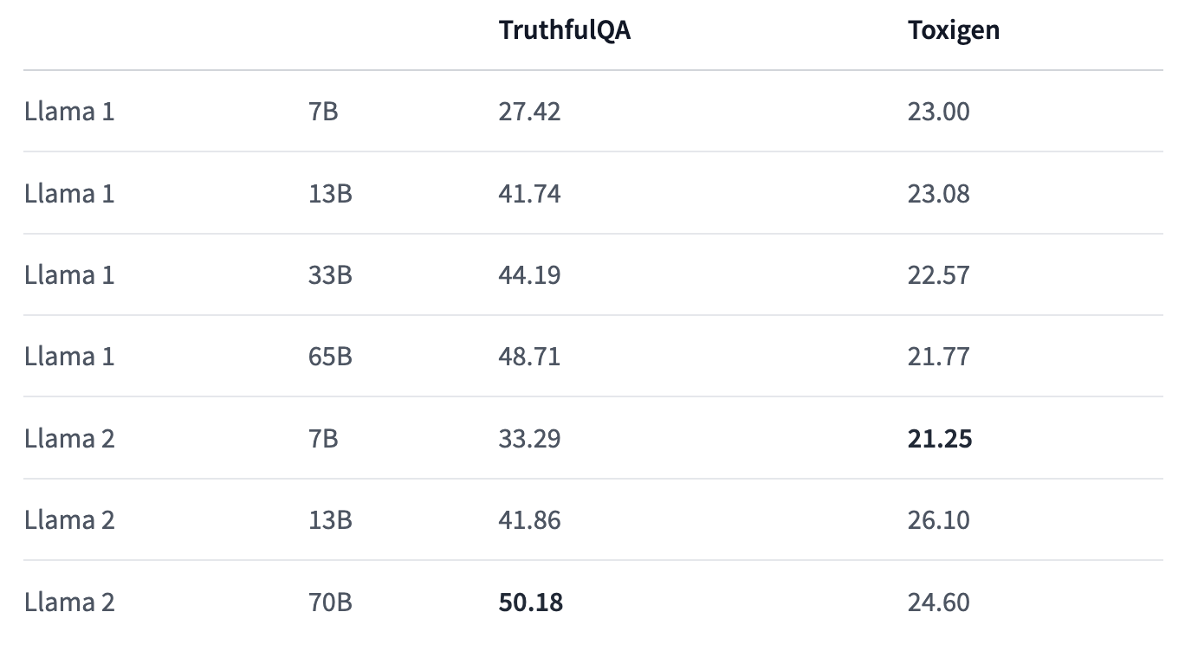
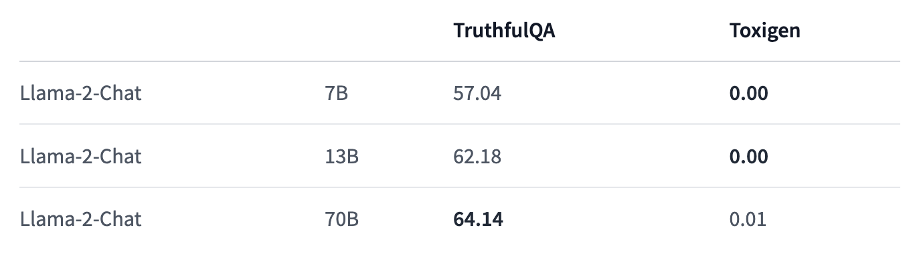
Just how good is RLHF?
No RLHF
Lllama-2 with RLHF is 0% toxic according to the Toxigen benchmark…
do we need harder benchmarks?
RLHF
Source: https://huggingface.co/meta-llama/Llama-2-7b

Slide 5
Suggestions for Group Reading
Llama-2 paper: https://arxiv.org/pdf/2307.09288.pdf
LoRA paper: https://arxiv.org/pdf/2106.09685.pdf
(or the AI Coffee Break video: https://www.youtube.com/watch?v=KEv-F5UkhxU)
qLoRA paper: https://arxiv.org/pdf/2305.14314.pdf
PHI-1.5: https://www.microsoft.com/en-us/research/publication/textbooks-are-all-you-need-ii-phi-1-5-technical-report/

Slide 6
Potential Research Questions Arising From qLoRA
By default, LoRA & qLoRA adapt all of the linear weights of a model - can we still get good results by training on some subset of the linear weights?
How does bit-precision affect performance and fairness?
Do RLHF-ed models maintain their fairness properties after low-rank adaptation to a new domain? Is it possible to show that domain adaptation could compromise RLHF properties?

Slide 7
Proposed tasks for next week
Read the Llama-2 paper & the LoRA/qLoRA paper
Working out a reasonable train/test setup for Hybrid Hiring
Low-rank adaptation of Llama-2-13b on Hybrid Hiring
Comparison of performance & fairness of low-rank model with GPT-4
Test of whether low-rank adaptation can perturb RLHF fairness properties

